Slide 1
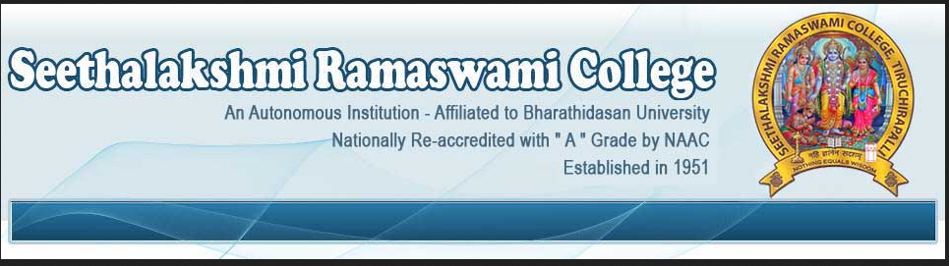
“MY SRC MY PRIDE”
BASIC CONCEPTS OF ADVANCED COMPUTING TECHNIQUES
Mrs. A. MULLAI
ASSOCIATE PROFESSOR
DEPARTMENT OF COMPUTER SCIENCE

Slide 2
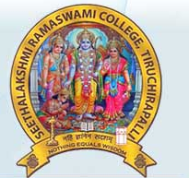
NETWORKS
is a digital telecommunications network - allows nodes to share resources.
In computer networks, exchange data with each other using a data link.
The connections between nodes are established using either cable media or wireless media.
Network computer devices that originate, route and terminate the data are called network nodes.
Nodes can include hosts such as personal computers, phones, servers as well as networking hardware.

Slide 3
…NETWORKS
support an enormous number of applications and
Services -
World Wide Web, digital video, digital audio, shared use of application and storage servers, printers, and fax machines, and use of email and instant messaging applications etc.
differ in the transmission medium used to carry their signals, communications protocols to organize –
network traffic, the network's size, topology and organizational intent.
The best-known computer network is the Internet.

Slide 4
COMPUTING
designing, developing and building hardware and software systems
processing, structuring, and managing various kinds of information
doing scientific research on and with computers
making computer systems behave intelligently and
creating and using communications and entertainment media

Slide 5
PERVASIVE (UBIQUTIOUS) COMPUTING
growing trend of embedding computational capability (generally in the form of microprocessors)
everyday objects to make them effectively communicate and perform useful tasks
minimizes the end user's need to interact with computers
Pervasive computing devices are network-connected and constantly available.

Slide 6
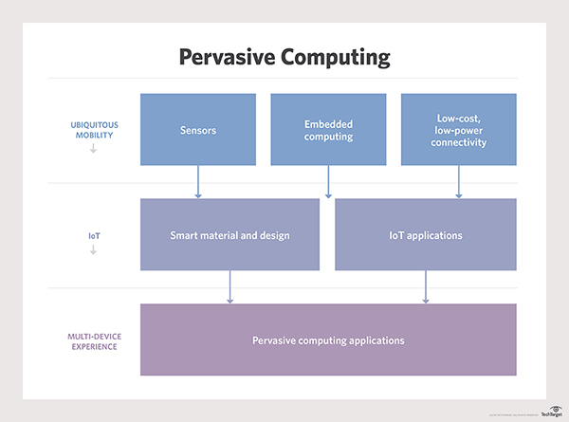
…PERVASIVE (UBIQUTIOUS) COMPUTING

Slide 7
…PERVASIVE (UBIQUTIOUS) COMPUTING
any device, at any time, in any place and in any data format across any network, and can hand tasks from one computer to another
Example:
laptops, notebooks and smartphones, but also tablets,
wearable devices, lighting systems, appliances and sensors, and so on.
The goal of pervasive computing is to make devices "smart,“
thus creating a sensor network capable of collecting, processing and sending data, and, ultimately, communicating as a means to adapt to the data's context and activity;
in essence, a network that can understand its surroundings and improve the human experience and quality of life.

Slide 8
…PERVASIVE (UBIQUTIOUS) COMPUTING
involve wireless communication and networking technologies, mobile devices, embedded systems, wearable computers, RFID tags, middleware and software agents.
Internet capabilities, voice recognition and artificial intelligence
Ex :
keep tracking on the location of the people/object
wearable devices –
Apple Watch informing a user of a phone call and allowing him to complete the call through the watch.

Slide 9
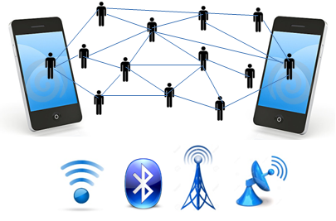
MOBILE (NOMADIC) COMPUTING
Users with portable computers
Network connections
Access – anywhere, anytime, anyplace
Normal fixed position to dynamic position
Work process – carried out - where it’s n’t previously possible

Slide 10
MOBILE COMMUNICATION
technology that allows transmission of
data, voice and video
via a computer or any other wireless enabled device
without having to be connected to a fixed physical link.
which involves −
Mobile communication
Mobile hardware
Mobile software

Slide 11
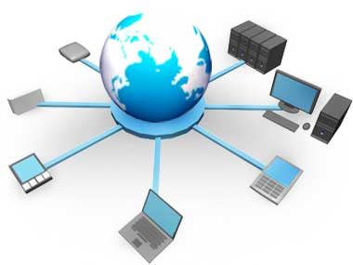
…MOBILE COMPUTING
protocols, services, bandwidth, and portals
The data format is also defined at this stage.
there is no collision with other existing systems which offer the same service.
radio wave-oriented.
That is, the signals are carried over the air
capable of receiving and sending similar kinds of signals.

Slide 12
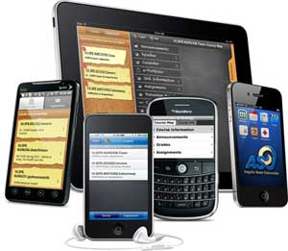
MOBILE HARDWARE
receive or access the service of mobility.
Ex: portable laptops, smartphones, tablet Pc's, Personal Digital Assistants.
capable of sensing and receiving signals.
operate in full- duplex - sending and receiving signals at the same time.
They don't have to wait until one device has finished communicating for the other device to initiate communications.
use an existing and established network to operate on.
In most cases, it would be a wireless network.

Slide 13

MOBILE SOFTWARE
Mobile software is the actual program that runs on the mobile hardware.
It deals with the characteristics and requirements of mobile applications.
it is the operating system of the appliance.

Slide 14
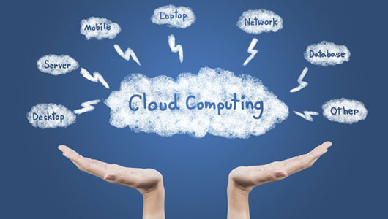
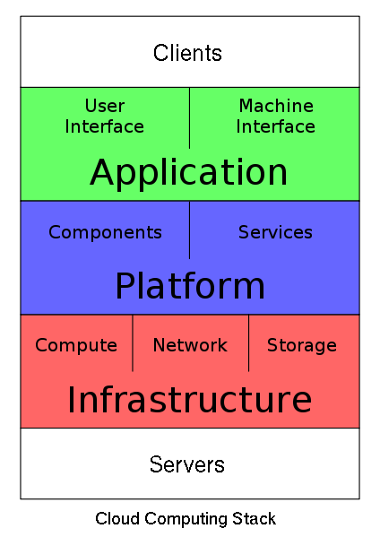
CLOUD COMPUTING
umbrella - Internet based development and services
Characteristics
  Remotely hosted: Services or data are hosted on remote infrastructure.
  Ubiquitous: Services or data are available from anywhere.
  Commodified: similar to traditional that of traditional utilities, like gas and electricity –
  you pay for what you would want!

Slide 15
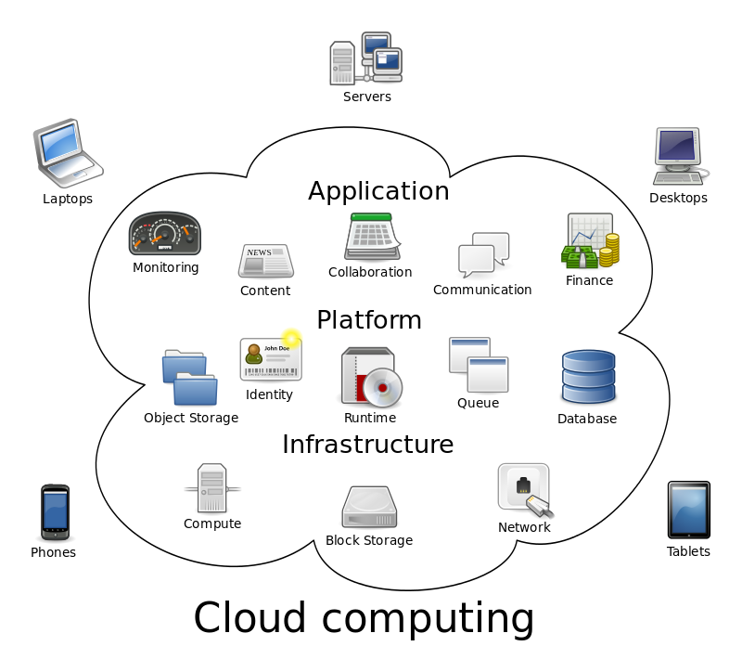
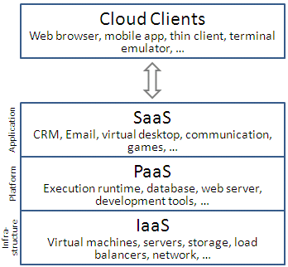
…CLOUD COMPUTING

Slide 16
…CLOUD COMPUTING
Cloud Computing
a new class of network based computing that takes place over the Internet,
  Utility Computing
  integrated and networked hardware, software and Internet infrastructure (called a platform).
  Using the Internet for communication and transport
  provides hardware, software and networking services to clients
hide the complexity and details from users and applications –
simple graphical interface or API (Applications Programming Interface).

Slide 17
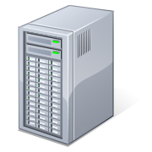
…CLOUD COMPUTING
Shared pool of configurable computing resources
On-demand network access
Provisioned by the Service Provider
APPLICATIONS
(SERVICES)
NETWORKS
STORAGE
(DATABASES)
SERVERS

Slide 18
OPPORTUNITIES AND CHALLENGES
The use of the cloud provides a number of opportunities:
  It enables services to be used without any understanding of their infrastructure.
  Cloud computing works using economies of scale:
    no longer need to buy their own software or servers.
    Cost would be by on-demand pricing.
    Vendors and Service providers claim costs by establishing an ongoing revenue stream.
  Data and services are stored remotely but accessible from “anywhere”.

Slide 19
ADVANTAGES OF CLOUD COMPUTING
Lower computer costs:
  You do not need a high-powered and high-priced computer to run cloud computing web-based applications.
  desktop PC does not need the processing power or hard disk space – UNLIKE traditional desktop software.
  PC can be less expensive, with a smaller hard disk, less memory, more efficient processor...
  does not even need a CD or DVD drive, as no software programs have to be loaded and
  no document files need to be saved.

Slide 20
…ADVANTAGES OF CLOUD COMPUTING
Improved performance:
  better performance - PC.
  Computers in a cloud computing system boot and run faster - because they have fewer programs and processes loaded into memory…
Reduced software costs:
  Instead of purchasing expensive software applications –
  can get most of what you need for free
    most cloud computing applications today, such as the Google Docs suite.
  better than paying for similar commercial software
    which alone may be justification for switching to cloud applications.

Slide 21
…ADVANTAGES OF CLOUD COMPUTING
Instant software updates:
  no longer faced obsolete software and high upgrade costs.
  application is web-based, updates happen automatically
    available the next time you log into the cloud.
  you get the latest version
    without needing to pay for or download an upgrade.
Improved document format compatibility.
  machine being compatible with other users' applications or OS.
  no format incompatibilities - sharing documents and applications in the cloud.

Slide 22
…ADVANTAGES OF CLOUD COMPUTING
Unlimited storage capacity:
  Cloud computing offers virtually limitless storage.
  Your computer's current 1 Tbyte hard drive is small compared to the hundreds of Pbytes available in the cloud.
Increased data reliability:
  Unlike desktop computing, in which if a hard disk crashes and destroy all your valuable data, a computer crashing in the cloud should not affect the storage of your data.
    if your personal computer crashes, all your data is still out there in the cloud, still accessible
  In a world where few individual desktop PC users back up their data on a regular basis, cloud computing is a data-safe computing platform!

Slide 23
…ADVANTAGES OF CLOUD COMPUTING
Universal document access:
  That is not a problem with cloud computing, because you do not take your documents with you.
  Instead, they stay in the cloud, and you can access them whenever you have a computer and an Internet connection
  Documents are instantly available from wherever you are
Latest version availability:
  When you edit a document at home, that edited version is what you see when you access the document at work.
  The cloud always hosts the latest version of your documents
    as long as you are connected, you are not in danger of having an outdated version

Slide 24
…ADVANTAGES OF CLOUD COMPUTING
Easier group collaboration:
  Sharing documents leads directly to better collaboration.
  Many users do this as it is an important advantages of cloud computing
    multiple users can collaborate easily on documents and projects
Device independence.
  no longer tethered to a single computer or network.
  Changes to computers, applications and documents - through the cloud.
  Move to a portable device - applications and documents are still available.

Slide 25
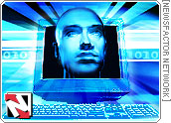
BIG DATA
Lots of data is being collected
and warehoused
  Web data, e-commerce
  purchases at department/
  grocery stores
  Bank/Credit Card
  transactions
  Social Network

Slide 26
…BIG DATA
Collection of data sets so large and complex
becomes difficult to process - database management tools or traditional data processing applications
“Big Data - scale, diversity, and complexity requires
new architecture, techniques, algorithms, and analytics
to manage it and extract value and hidden knowledge from it.

Slide 27
…BIG DATA
big data - predictive analytics to extract value from information and rarely refers to size of the information set.
may lead to the confident and better decision making - in developing greater operational efficiency, reduction in the cost and the risk.
larger than the commonly used software tools to capture, curate and manage and process information within a defined time.
The size is continuously increasing - from few terabytes to petabytes.
characterized by high volume, velocity, and variety to need specifically applied science and analytical ways for its change into value.

Slide 28
…BIG DATA
The big data has many characteristic and they are as follows:
Volume
Variety
Velocity
Variability
Veracity
Complexity

Slide 29
…BIG DATA
Volume:
it is the size of the data that explains the value and information & whether it can be viewed as a big data or not.
Variety:
it determines the class the big data belongs to
it is also an essential factor that the data analyst should know.
Velocity:
refers to the speed of production of the information.

Slide 30
…BIG DATA
Variability:
it causes an issue to the people who analyze the information.
Veracity:
The quality of the information may vary a lot
precision of analysis depends on the veracity factor of the source information.
Complexity:
The management of the data can become a difficult process -
huge information comes from different sources.
All these information needs to linked, correlate and connects with each other
to acquire the data that is supposed to be transferred by this information.

Slide 31
…BIG DATA
Generally, the factory work and the cyber-physical systems have a 6C system and this is as below:
Connection
Cloud
Cyber
Content
Community
Customization

Slide 32
STRUCTURE OF BIG DATA
The structure of the big data can be explained by the following:
Structured
Semi-structured
Unstructured
Structured:
includes the traditional sources of information.
Semi-structured:
includes many sources of the big data.
Unstructured:
includes the information like video data and audio data.

Slide 33
ADVANTAGES OF THE BIG DATA
The advantages of the big data are as below:
The big data is already a vital part of the $64 billion databases and the data analytics market.
It furnishes commercial opportunities of a comparable.

Slide 34
APPLICATIONS OF BIG DATA
The applications of the big data are in the following fields:
Government
International development
Manufacturing
Cyber-physical models
Media
Technology
Private sector
Science
Science and research

Slide 35
…APPLICATIONS OF BIG DATA
Government:
Ex: In USA the year 2012, Obama declared the big data research and development initiative - it is used to address many issues faced and also utilized by the Indian government.
International development:
cost-effective opportunities to enhance the decision in critical advancement areas like health care, employment opportunities and crime, security and natural disaster.
Manufacturing:
In manufacturing, the big data furnishes an infrastructure for transparency in manufacturing or producing industry.

Slide 36
...APPLICATIONS OF BIG DATA
Cyber-physical models:
The present PHM implementations make avail of data during the actual usage
analytical step by step procedures can do more precisely - when more data is included.
Media: I
it is used in the internet of things - the activities like targeting of computers and data capturing.
Technology:
In the technology, it is used in the websites like eBay, Amazon and Facebook and Google utilize it.

Slide 37
...APPLICATIONS OF BIG DATA
Private sector:
includes the retail, retail banking, and real estate.
Science:
The best example for its application in science is about the Large Hardom collider that represented 150 million sensors transmitting information 40 million times per second.
The big data also has the application in the science and research.
The big data will be very advanced in the future as $15 billion is invested in software firms that are specialized in the data management and the data analytics.

Slide 38
REFERENCES
Principles Of Mobile Computing, Uwe Hansmann, Lothar Merk Martin S. Nicklous , Thomas Stober, Springer International Second Edition.
Pervasive Computing Technology and Architecture of Mobile Internet Applications, Jochen Burkhardt, Dr. Horst Henn, Stefan Hepper, Klaus Rintdorff, Thomas Schack, Pearson Edition
Cloud Computing, Dr. Kumar Saurabh, Wiley India Publication.
Grid Computing, Joshy Joseph, Craig Fellenstein, Pearson Edition.
Internet of Things – From Research and Innovation to Market Deployment, Ovidiu Vermesan, Peter Friess, River Publishers, 2014.

Slide 39
REFERENCES
https://en.wikipedia.org/wiki/Mobile_computing
https://www.techopedia.com/definition/2/cloud-computing
https://www.techopedia.com/definition/28247/internet-of-things-iot
https://www.oracle.com/in/big-data/guide/what-is-big-data.html
https://www.techopedia.com/definition/28247/internet-of-things-iotet
https://www.oracle.com/in/big-data/guide/what-is-big-data.html

Slide 40
MY SRC MY PRIDE
THANK YOU !

